Slide 1
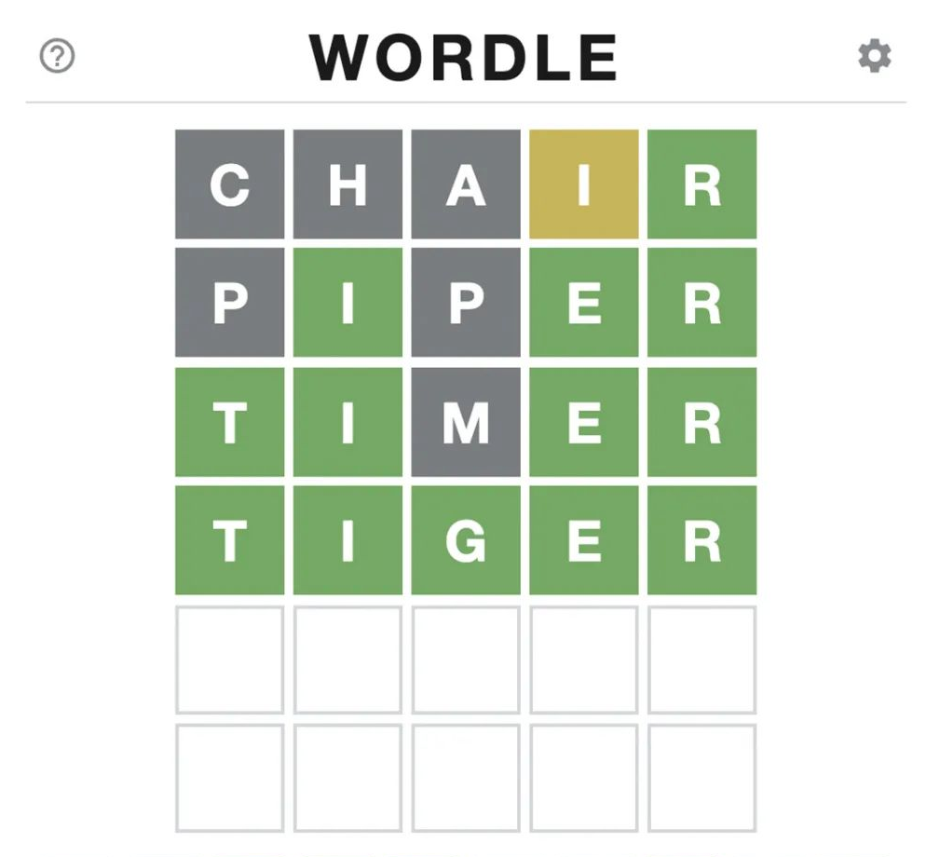
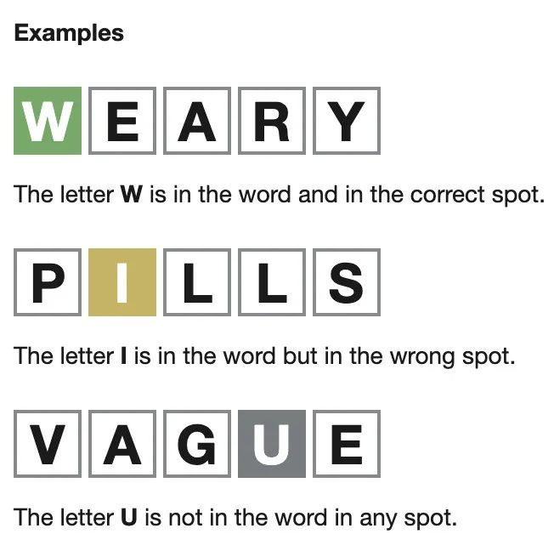
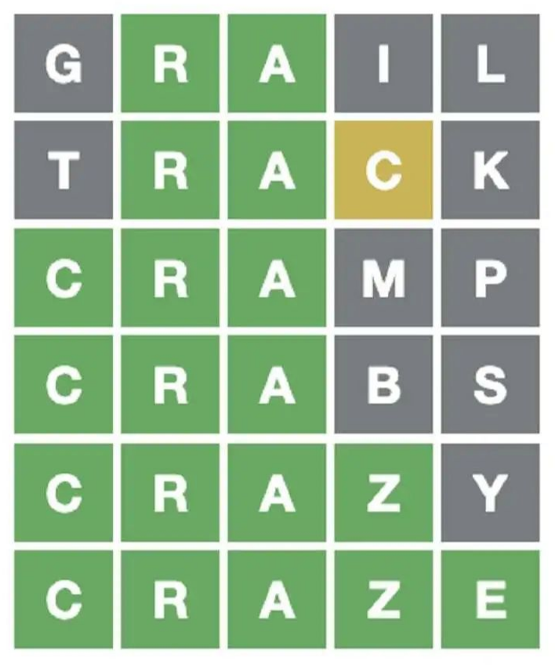
WORDLE
Examples
W
E
A
R
Y
P
I
L
L
S
A
G
U
E
V
A
G
U
E

Slide 2
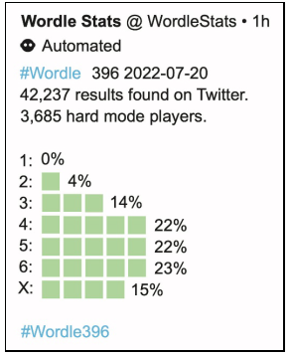

Slide 3
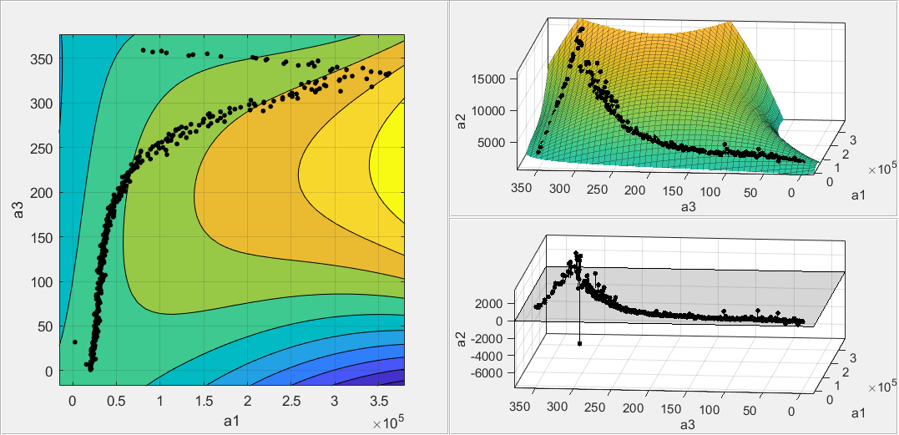
Contour graph
Fitting graph
Residual graph

Slide 4

Data Cleaning
Take logarithm of the data
ARIMA with second-order difference
Prediction of target data and intervals
Exponential Reduction

Slide 5
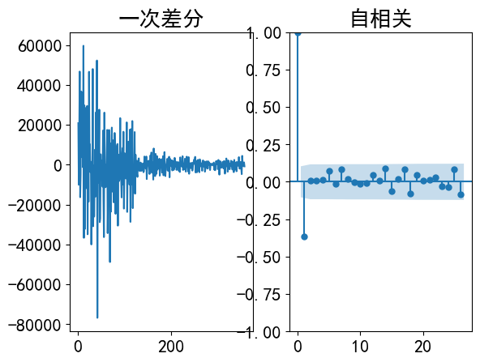
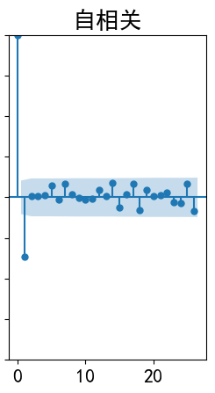
Second-order difference
Self-relation
1.00
60000
0.75
40000
0.50
20000
0.25
0
0.00
-20000
-0.25
-40000
-0.50
-60000
-0.75
-80000
-1.00

Slide 6
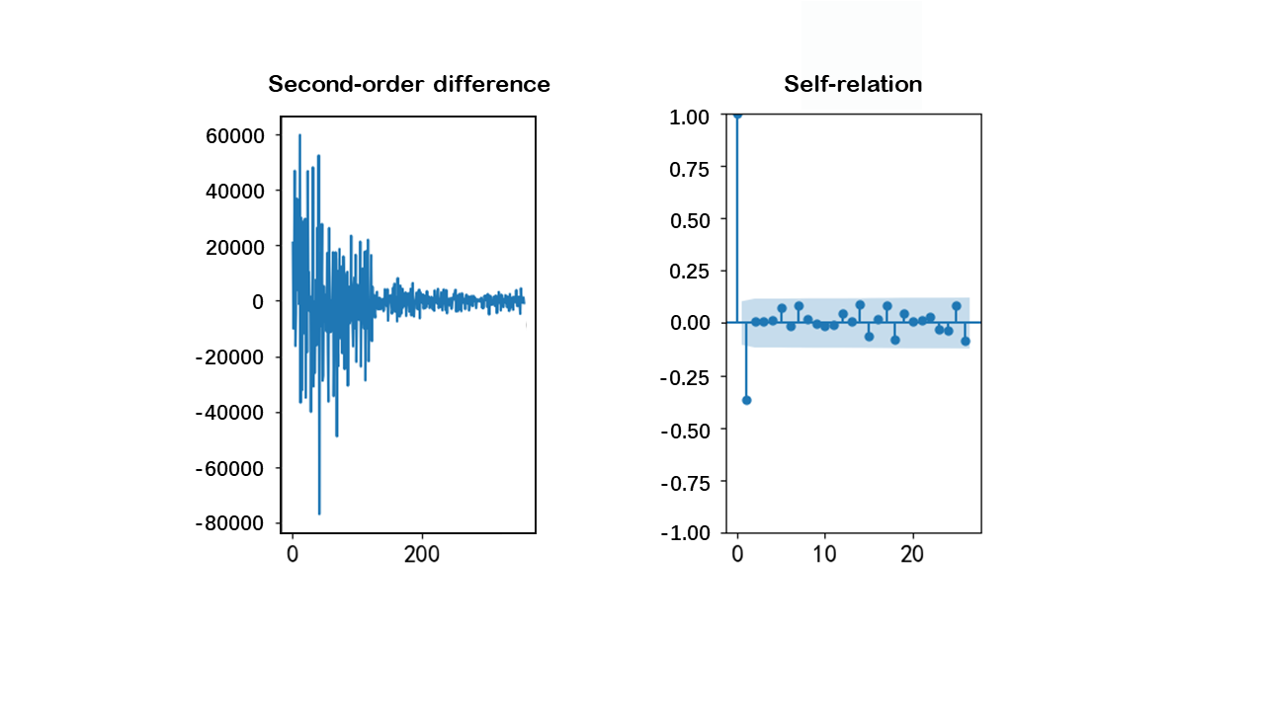
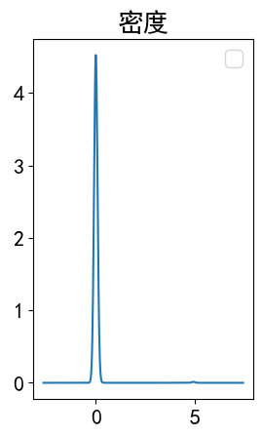
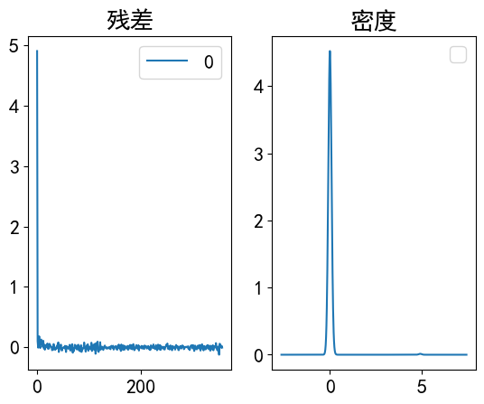
Autocorrelation
Residuals
Density

Slide 8
===============================================
Fitting model： f(x) = a/(b+exp(-c\*x))
---------------------------------------------------------------------------------
Coefficients ( with 95% confidence bounds):
a = 0.03553 (0.03355, 0.03752)
b = 0.3674 (0.3479, 0.3869)
c = 0.01658 (0.01583, 0.01733)
---------------------------------------------------------------------------------
Goodness of fit：
SSE: 0.005503
R-square: 0.9682
Adjusted R-square: 0.968
RMSE: 0.003943
===============================================

Slide 9
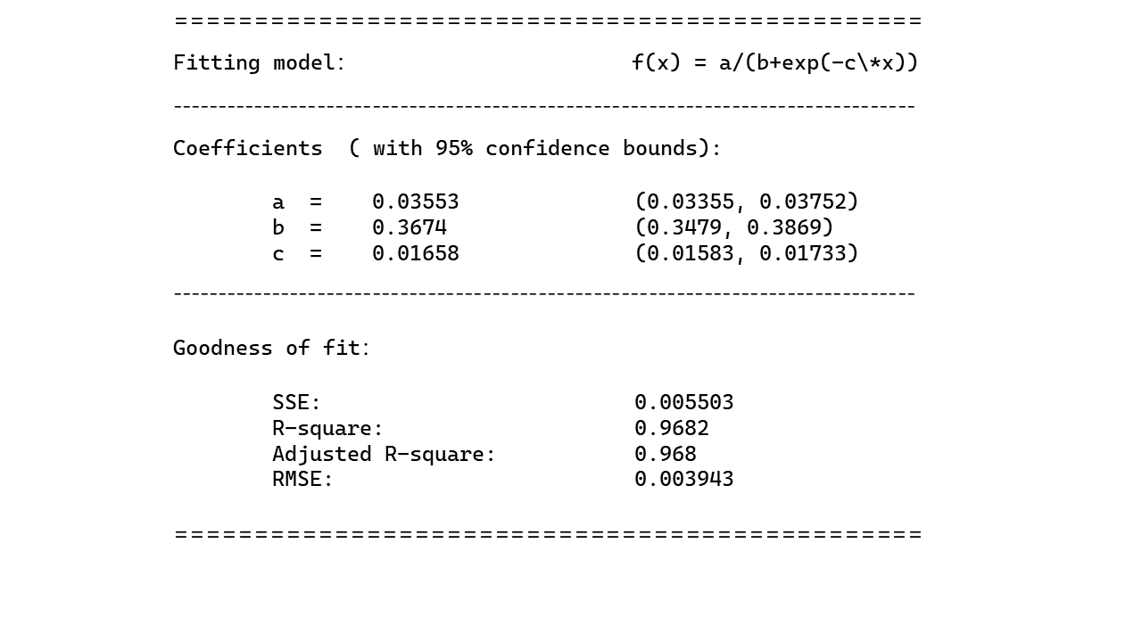

Slide 10
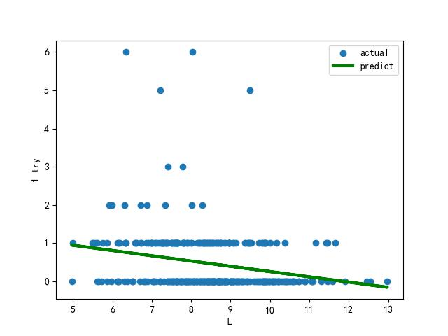
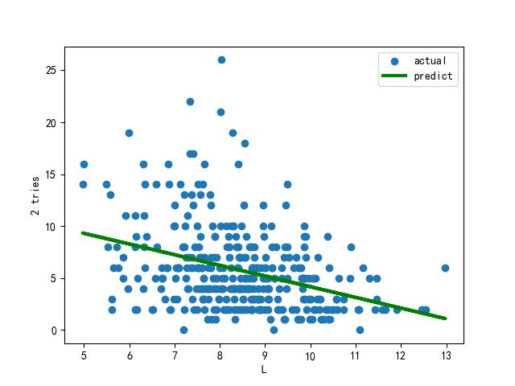
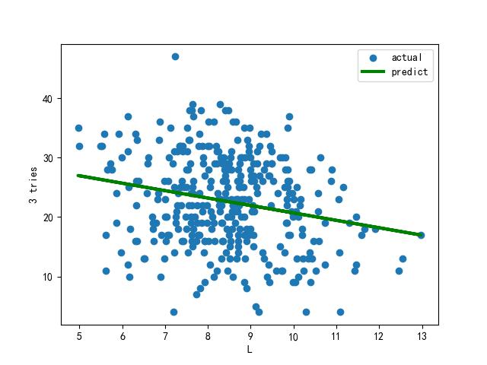
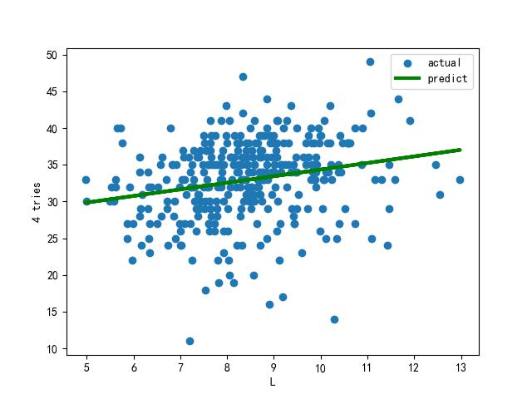
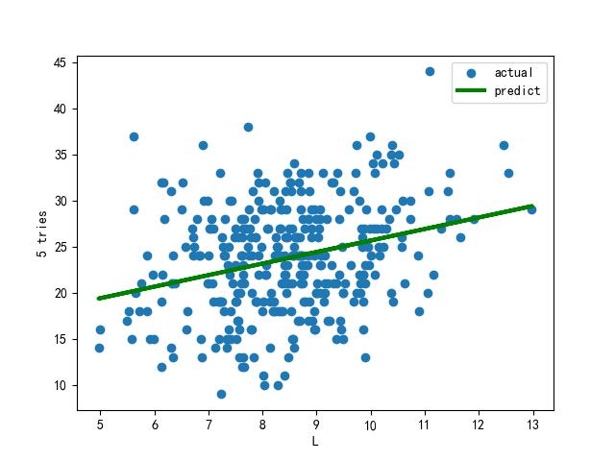
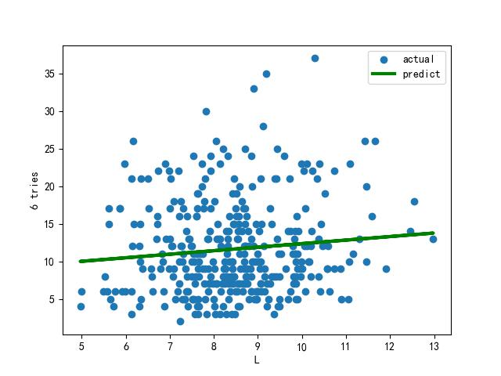
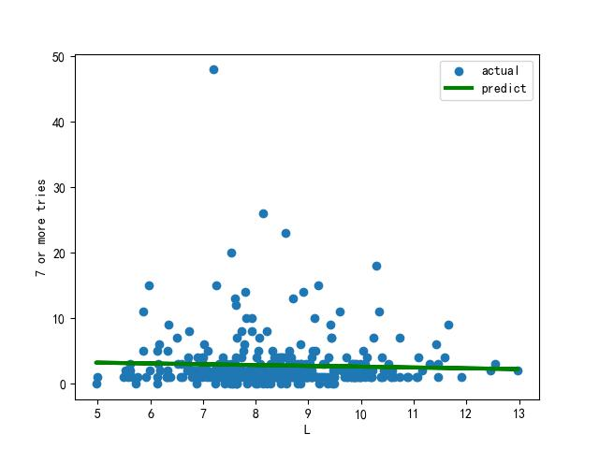
(a) Linear Fit of 1 Try
(b) Linear Fit of 2 Tries
(c) Linear Fit of 3 Tries
(d) Linear Fit of 4 Tries
(e) Linear Fit of 5 Tries
(f) Linear Fit of 6 Tries
(g) Linear Fit of 7 or More Tries

Slide 11
Data Cleaning
Second-order Difference
Searching for the Right Attributes
Defining the Difficulty of Vocabulary.
Categorizing Vocabulary by Difficulty
ARIMA Model
Defining the Frequency Attribute
Regression Analysis
Prediction of Score Distribution.
Prediction of Target Data and Intervals
Analyzing the Fitted Lines.
Interesting Features of the Data
Note : & Problem1 Problem2 Problem3 Probem4
&

Slide 12
(a) Linear Fit of 1 Try
(b) Linear Fit of 2 Tries
(c) Linear Fit of 3 Tries
(d) Linear Fit of 4 Tries
(e) Linear Fit of 5 Tries
(f) Linear Fit of 6 Tries
(g) Linear Fit of 7 or More Tries

Slide 13
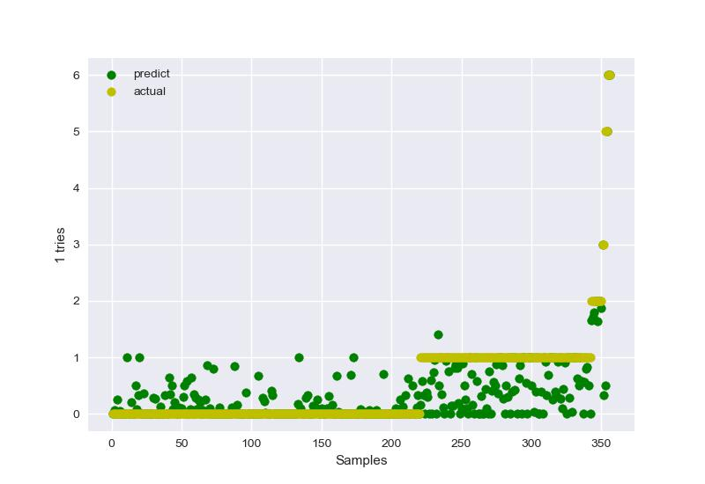
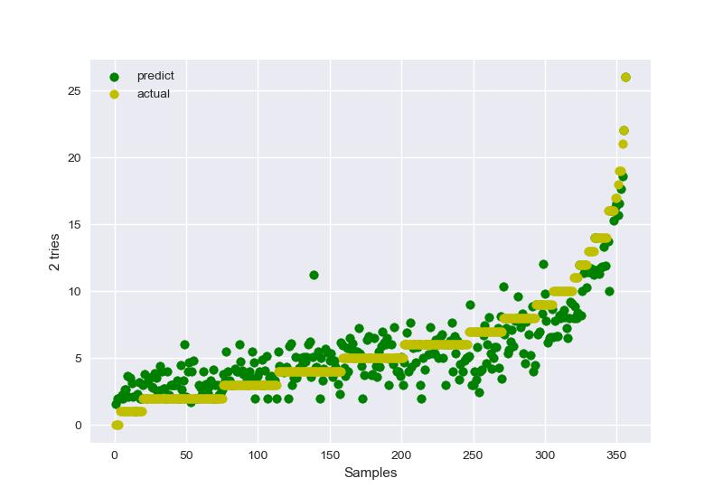
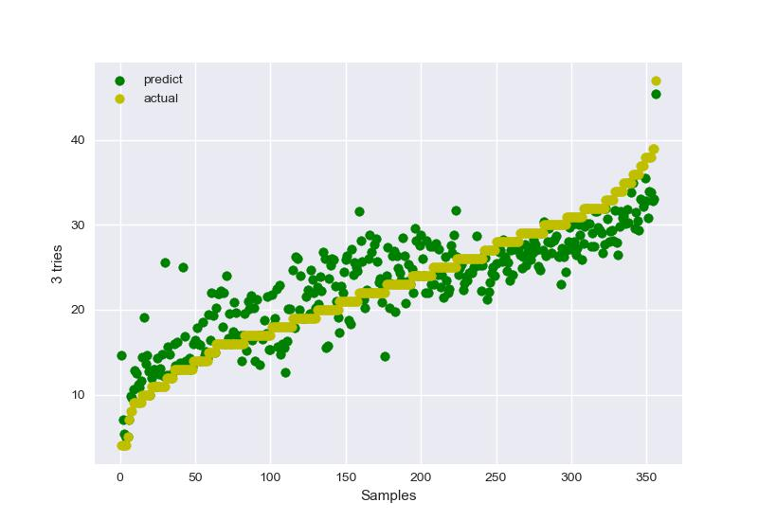
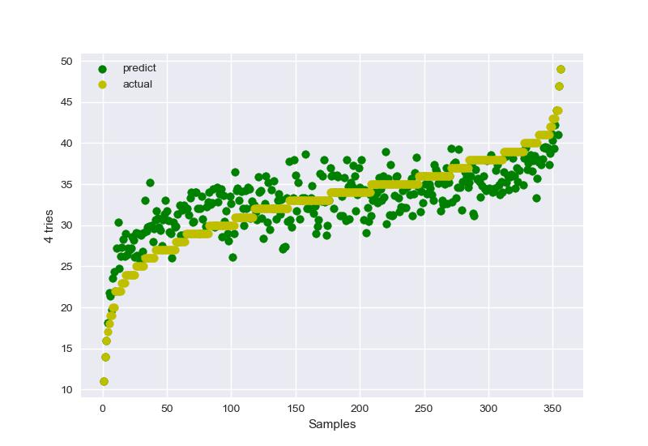
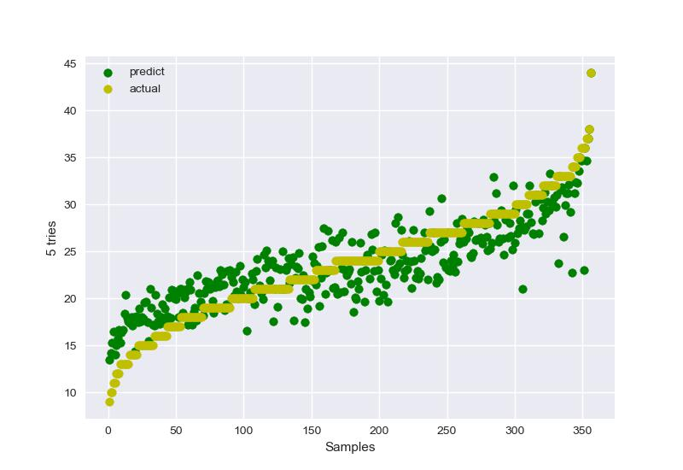
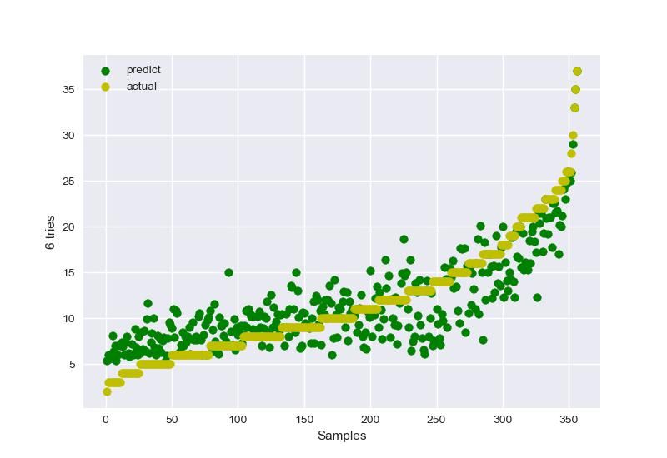
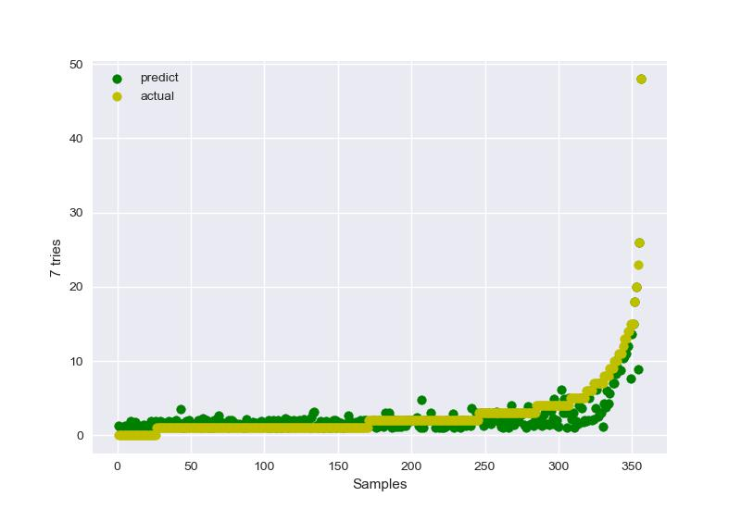
(a) Prediction of 1 Try
(b) Prediction of 2 Tries
(c) Prediction of 3 Tries
(d) Prediction of 4 Tries
(e) Prediction of 5 Tries
(f) Prediction of 6 Tries
(g) Prediction of 7 or More Tries

Slide 14
Number of attempts | Percentage of scores

Slide 15
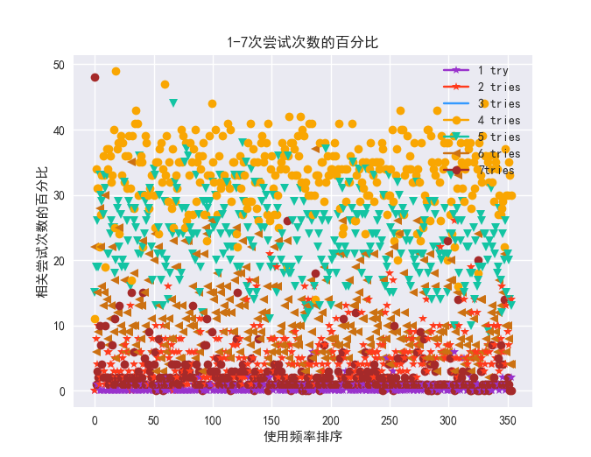
Percentage of attempts
Ranking of usage frequency

Slide 16
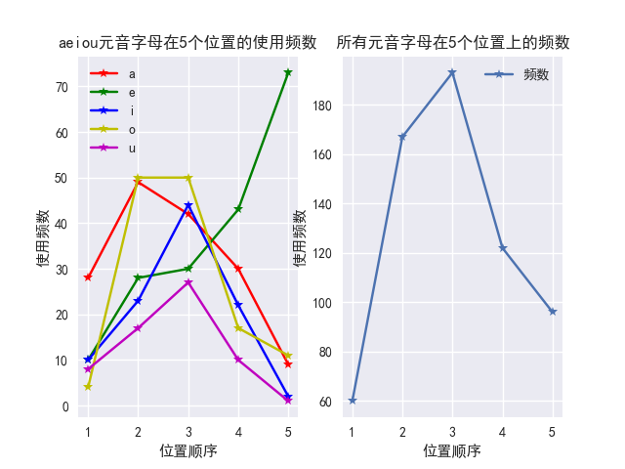
Frequency of a,e,I,o,u
Frequency of vowel letters
F
Position Order
Position Order

Slide 17
